Slide 1
Science of Living System
BS20001
Ritobrata Goswami
School of Bio Science
Email: ritobrata.goswami@iitkgp.ac.in
Tel: 03222-260518

Slide 2
Lecture | Date | Topic
1 | 03/01/2018 | Nucleic acids – 1
2 | 10/01/2018 | Nucleic acids – 2
3 | 17/01/2018 | Transcription and Translation – 1
4 | 24/01/2018 | Transcription and Translation – 2
5 | 31/01/2018 | Protein structure – 1
6 | 07/02/2018 | Protein structure – 2 / Discussion and Revision
** | 14/02/2018 | CLASS TEST - 1
7 | 28/02/2018 | Enzymes
8 | 07/03/2018 | Cellular architecture
9 | 14/03/2018 | Cell division and apoptosis
10 | 21/03/2018 | Host defense/vaccines
11 | 28/03/2018 | Genetic Engineering & its impact
** | 04/04/2018 | CLASS TEST - 2
** | 11/04/2018 | DISCUSSION AND REVISION

Slide 3
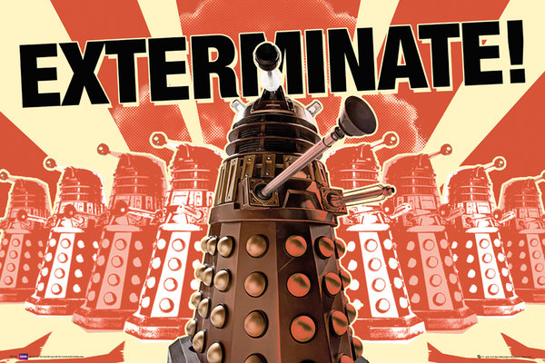
Host Defense and Prevention of Diseases

Slide 4
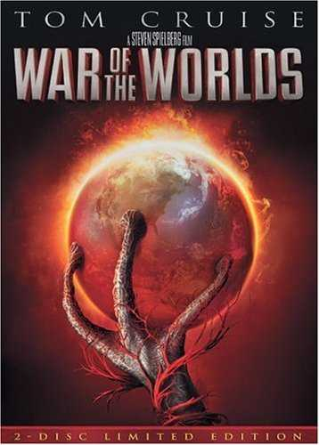
Story: H.G. Wells
Direction: Steven Spielberg

Slide 5
Human Diseases
Infections (caused by bacteria, virus, fungi etc)
Cancers (several known and unknown reasons)
Autoimmune diseases (Failure of our immune system in recognition of self vs non-self)
Immunodeficiency (lack/defect in immune system)

Slide 6
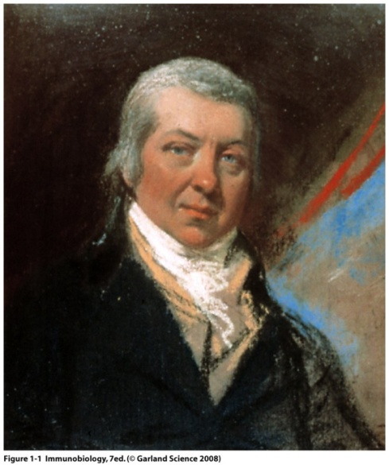
Immunology: The Beginning
In 15th century dried crusts from small pox were either inhaled or inserted into small cuts in the skin (variolation).
In 1796, Jenner demonstrated that inoculation with cow-pox protects against small pox, a lethal disease at that time. A process he termed Vaccination
Louis Pasteur’s hypothesis: Weakened or attenuated strain could be administered to protect from that specific strain causing disease - Vaccine
Edward Jenner: father of Immunology
Robert Koch: Infectious diseases caused by micro-organisms (1905)
Louis Pasteur (1822-1895): Anti-Rabies vaccine
Emil von Boehring: Antibodies with neutralizing ability (1901)
Ronald Ross: Transmission of Malaria (1902)
Elie Metchnikoff: Phagocytic cells, macrophages (1908)
Notes:
Dates…

Slide 7
The Immune System: Body’s Defense Mechanism
A complex system that encompasses every organ and compartment of the body
The main objective is to seek, identify and kill invaders
Highly adaptable (can act against pathogens ranging from ~ 30nm to ~100 cm)
Distinguishes between self and foreign and mount response to only foreign while preserving self (‘us’ vs ‘them’)

Slide 8
Challenges of the Immune System
Pathogen-induced diseases:
Autoimmune diseases: When self is attacked by the immune system
Cancer: Failure of Immune system to attack defective cells
Immune deficiency: A component of immune system is absent/defective

Slide 9
Our immune systems generate an almost infinite variety of cells and substances
Foreign Recognition
Effector Response
Memory
To eliminate or neutralize particle
Upon 2° exposure
Produces enhanced response
Active immunity: Immunity that will generate long term memory
Passive immunity: Immunity that will generate short term memory

Slide 10
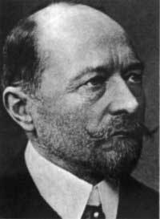
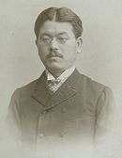
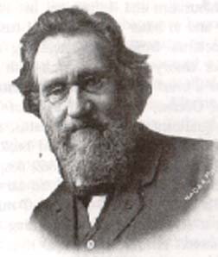
First insights into mechanics of immunity
Emil von Behring
1880’s- Metchnikoff discovered phagocytic cells that ingest microbes and particles
cells confer immunity
1890- von Behring and Kitasato discovered blood sera could transfer immunity
liquid of blood confer immunity
What confers immunity…
cells or serum?
S. Kitasato
Elie Metchnikoff

Slide 11
Both serum and cells contribute to immunity
1930’s – early techniques made it easier to study humoral elements [than cellular ones]
discovery of active component of blood – “Antibody”
1950’s – discovery of T and B cells
Later discoveries linked lymphocytes to both cellular and humoral immunity

Slide 12
The immune system
A functional system – NOT an organ system:
A very complex system that includes:
Skin – physical barrier
Lining of mucus membranes – physical barrier
Secretions – tears, mucus etc - antimicrobial
Blood cells and vasculature – White blood cells (WBCs)
Bone marrow—source of Hematopoietic Stem Cell (HSC)
Lymphatic system and lymphoid organs
Most tissues – have resident immune cells

Slide 13
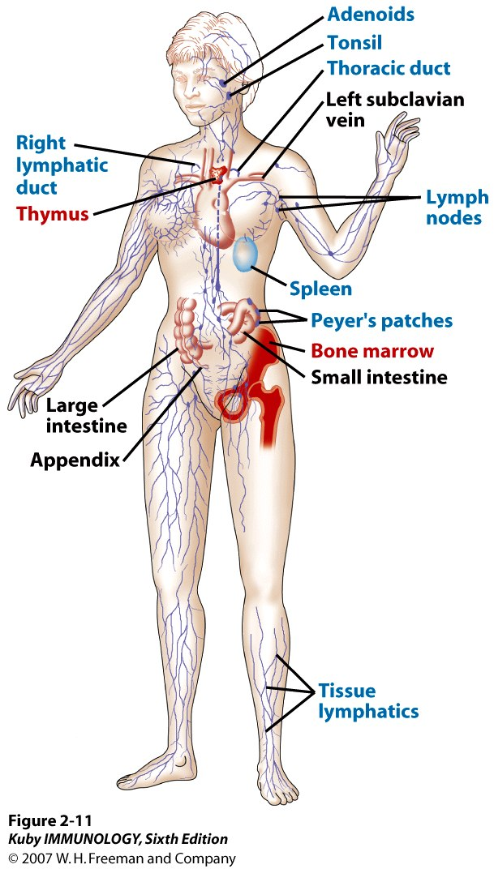
Distribution of the Immune System
Red: primary lymphoid organs
Blue: secondary lymphoid organs
T cells are matured in the thymus
The bone marrow contains
blood-forming Stem cells,
and makes B cells, innate
cells, and all other blood
cell types.

Slide 14
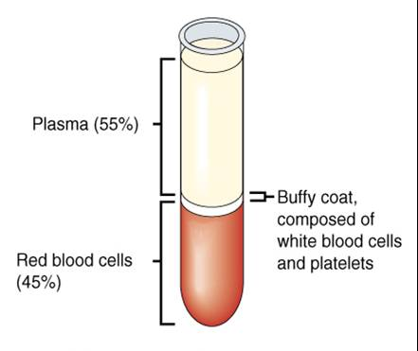
Innate immune system: components of Blood
Centrifugation of blood
Immune component
Antibodies and others
WBCs

Slide 15
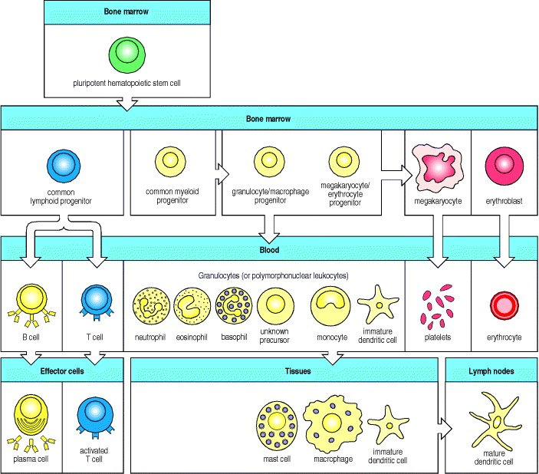
Where do immune cells come from?

Slide 16
Two modes of immunity
In response to pathogens, vertebrate immune systems use two interconnected systems:
Innate immunity: in born
Adaptive immunity: acquired during the life-span

Slide 17
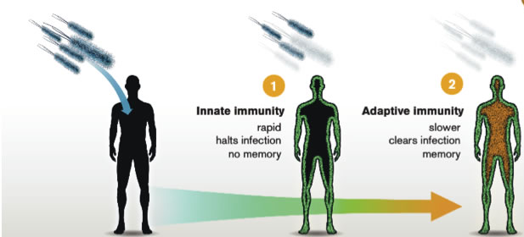
Host Defense Mechanisms: Innate and Adaptive
Innate Immunity
Rapid
Halts Infection
No Memory
Adaptive Immunity
Slower
Clears Infection
Memory
2011: Nobel Prize in Physiology and Medicine:
Bruce Beutler, Jules Hoffman : Innate Immunity
Ralph Steinman : Adaptive Immunity
Notes:
Innate can kill infectious agents

Slide 18
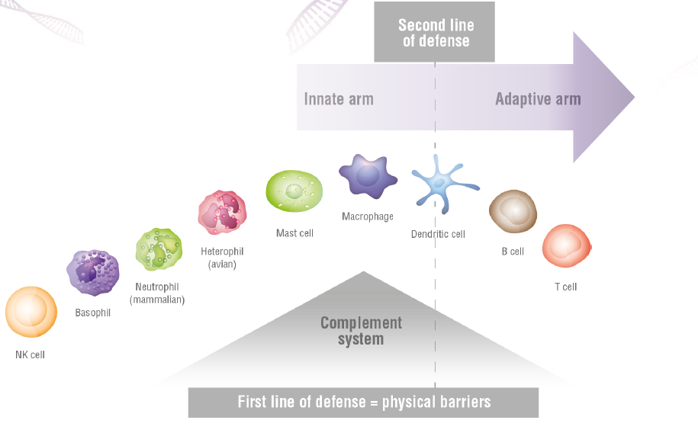
Immune system defends against infection

Slide 19
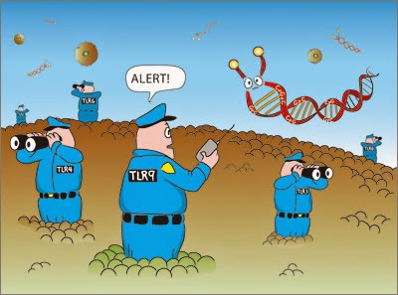
Innate immune system
http://sciencebyadam.blogspot.in/

Slide 20
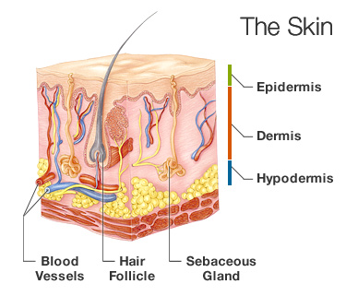
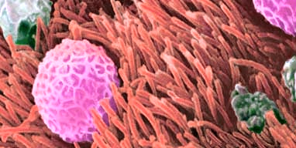
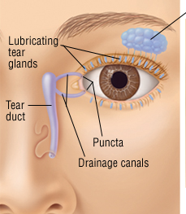
Anatomical Barriers - Mechanical Factors
Skin
Mucous
Flushing action of
saliva, tears, urine

Slide 21
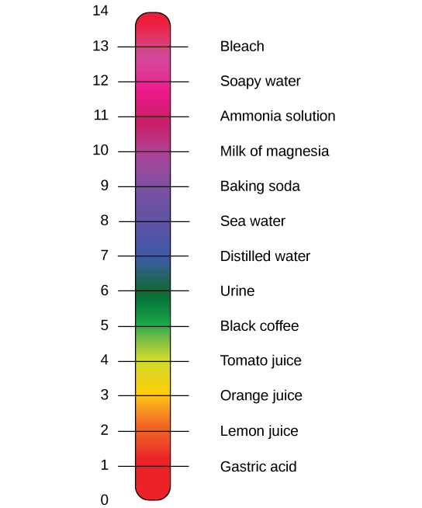
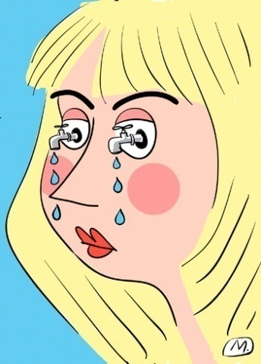
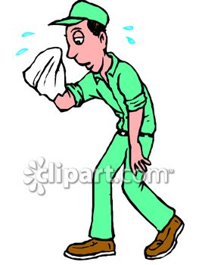
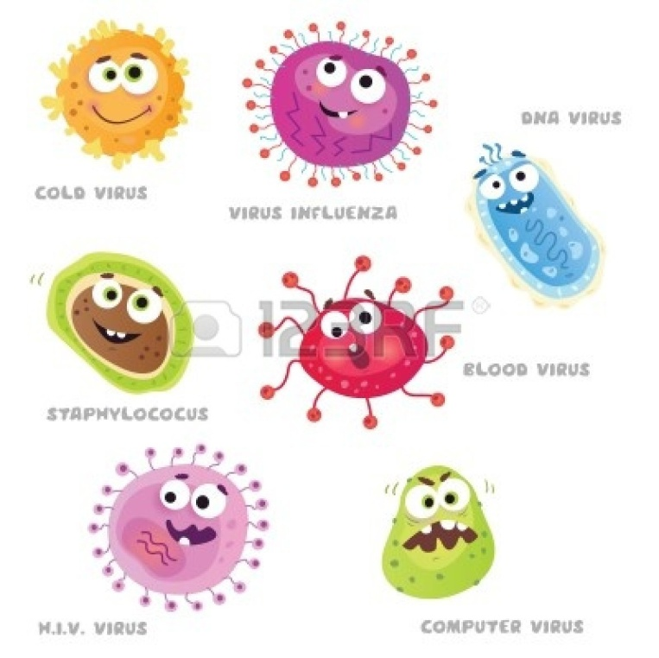
Anatomical Barriers – Chemical factors
Antimicrobial
Peptides in sweat
HCl in stomach
Lysozyme in tears /saliva
Notes:
Sweat – AMP – dermcidin

Slide 22
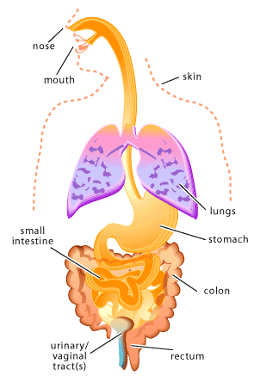
Anatomical Barriers – Biological factors
Symbiotic (commensal) microbial flora:
microbes in many parts of the body
> 1000 species of bacteria
competes with pathogens for nutrients and space

Slide 23
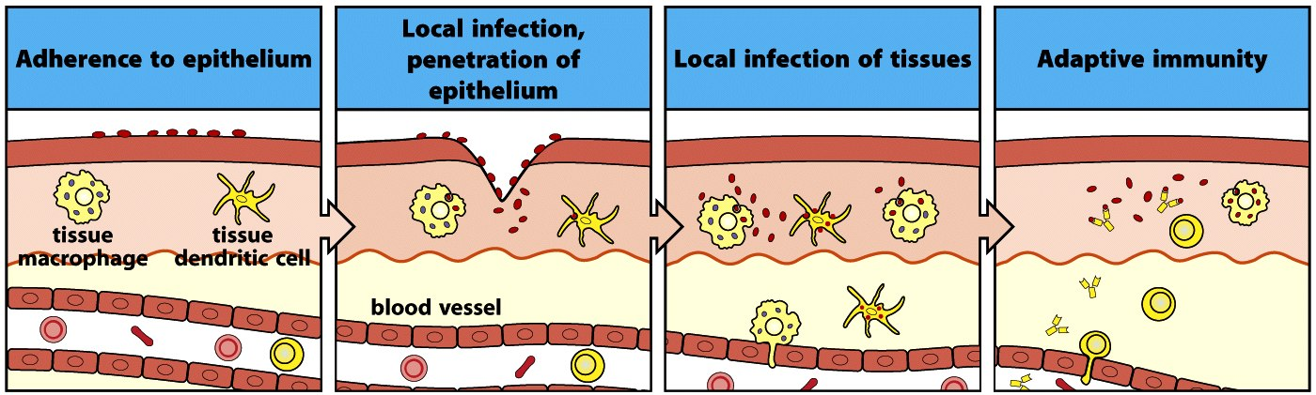
Epithelial Barriers: what happens after a breach?
Innate immunity
Janeway 7th edition

Slide 24
Epithelial Barriers: what happens after a breach?
Inflammatory response: A fundamental type of response by the body to injury/localize infection is characterized by the classical signs of :
Increase in blood volume in the area
1. Vasodilation
Heat and Redness
2. Vascular permeability increases
Leakage of fluid from blood vessel
Swelling, Pain
Inflammation: Heat, Redness, Swelling, Pain
Leukocytes enter the tissue from the local blood vessels and halts or clears the potential threat

Slide 25
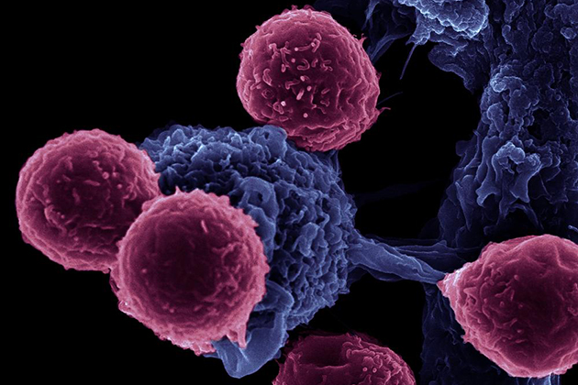
Components and Mechanisms of the Adaptive Immune Response
An image of immune cell communication, showing dendritic cells interacting with T cells, taken using an FEI microscope, magnification 16,000x. (Rita Serda/FEI Image)

Slide 26
Adaptive Immunity: Our most powerful defense
More tuned to subtle molecular differences
Takes more time to develop; antigen specific
Gradual resolution of infection is outcome; depends on B and T cells
Able to better recognize, eliminate, & remember the invading pathogen
Development is dependent upon earlier innate pathways
Adaptive immunity provides a second & more comprehensive line of defense based on the struggles of innate immunity

Slide 27
Components of Adaptive Immune Response
Cellular immunity:
Mediated by cells
T cells
B cells
Humoral immunity:
Involves substances in humor (body fluid, i.e., blood, lymph)
Mediated by antibodies etc
Nobel Prizes:
2011- Discovery of DC and its role in adaptive immunity
1996- Role of MHC (APC)-TCR (T cell) interaction in adaptive immunity
1987- Genetic basis of diversity of antibodies i.e produced from B cells
1984- Production of monoclonal antibodies
1980- Discovery of MHC
1972- Chemical structure of Antibody

Slide 28
Adaptive Immune Response: An Overview
Dendritic cells (MHC)
CD8 & CD4 T Cell (TCR)
Cytotoxic T cell
(TCR)
Helper T cell
(TCR)
Virus Infected/abnormal cell
(with antigenic peptide loaded on MHC I)
B Cell
Plasma cell
(antibody producing B cell)
Killing of infected cell
Neutralization
Induction of phagocytosis
Antibody

Slide 29
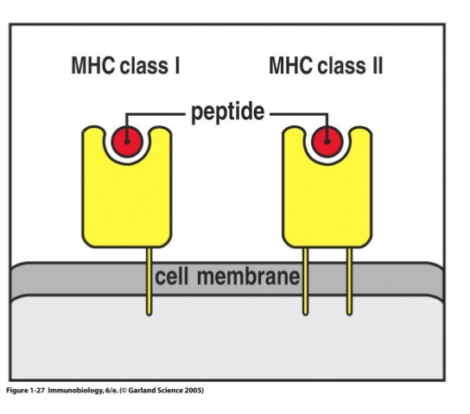
‘Professional’ Antigen Presenting Cells (APCs)
express both MHC class I and class II molecules
Notes:
B cells
Dentritic cells- CD4 and CD8
Macrophage- CD4 only (phagocytosis only)

Slide 30
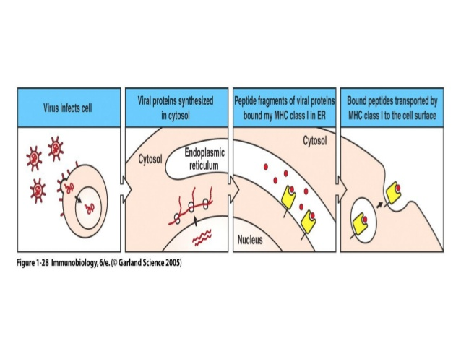
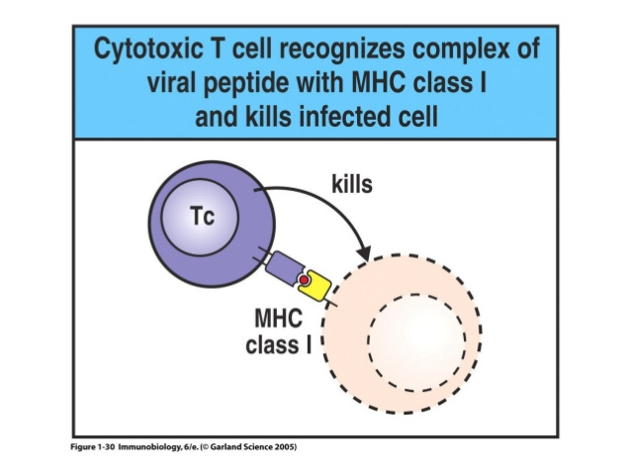
Antigen presentation to cytotoxic T cells

Slide 31
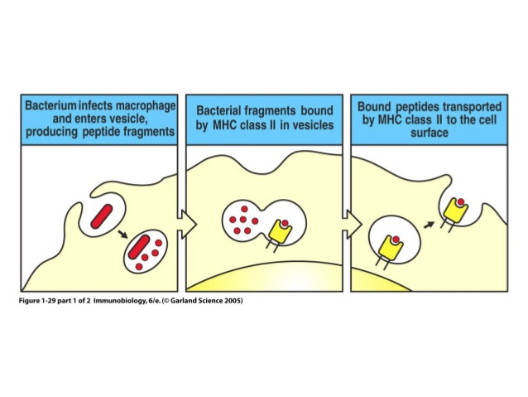
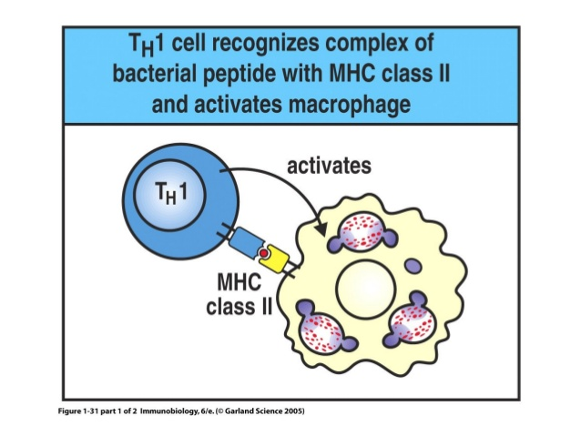
Antigen presentation to helper T cells

Slide 32
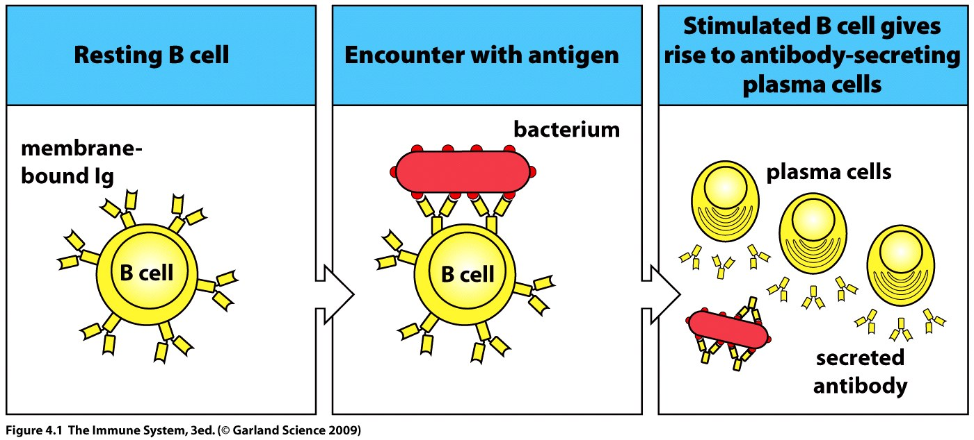
B cell also recognizes antigens and produces antibodies
1. Each B cell can recognize only one antigen
2. Finally, that B cell get activated and differentiated in to numerous plasma cells
3. All of these plasma cells produce same antibody in a very efficient manner
4. These antibodies are then utilized in the clearing of initial antigen/antigen providing microorganisms, which was initially detected by B cell
Notes:
Figure?

Slide 33
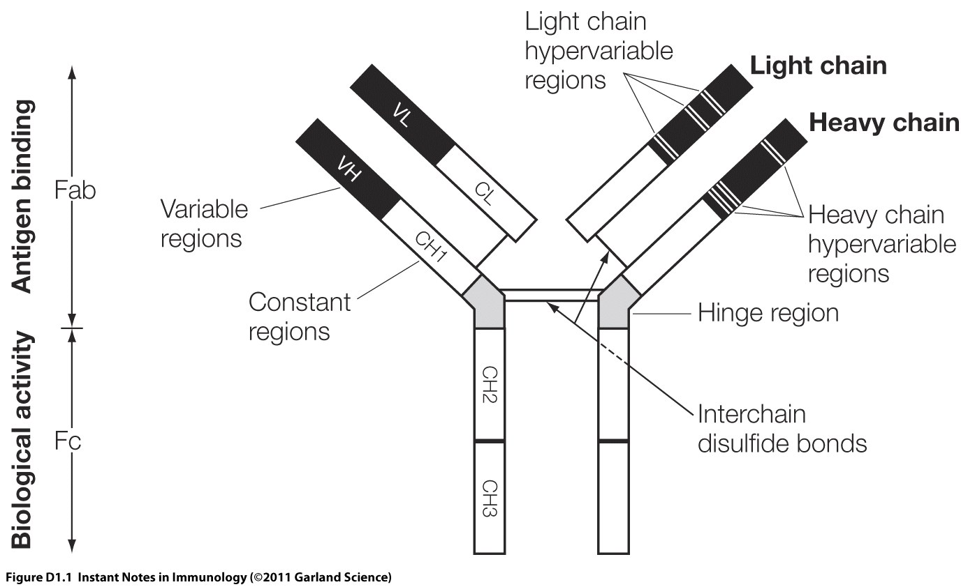
Structure of an Antibody molecule

Slide 34
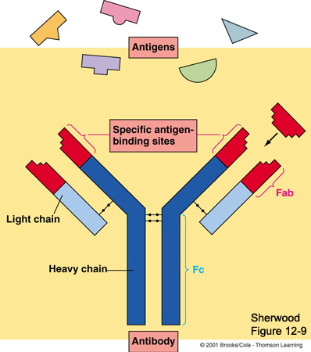
Fab region
Variable region of the antibody
Tip of the antibody
Binds the antigen
Specificity of antigen binding determined by
V_{H} and V_{L}
Fc region
Constant region
Base of the antibody
Can bind cell receptors

Slide 35
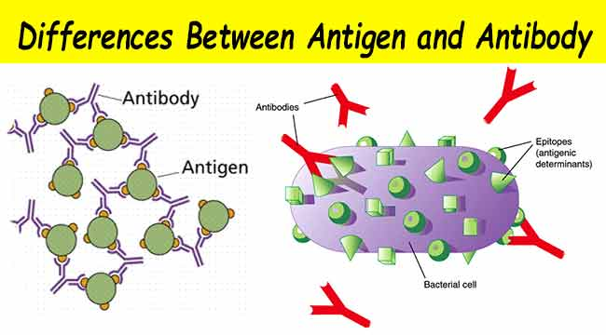
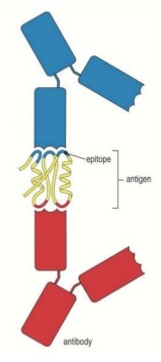
Antigen | Antibody
Any foreign substance that induce immune response | Glycoproteins that are formed to fight against antigen
Generally proteins, but can be carbohydrates, lipids etc | Proteins in nature
Triggers the formation of antibodies | Variable site has antigen binding domain
Cause diseases or allergic reaction | Protects the immune system by lysis of antigenic material

Slide 36
Adaptive Immune Response: Key Points
Initiated by innate system
Diverse set of receptors
Recognizes pathogen-specific epitopes (immune specificity)
Immune memory
Maintenance of Self Tolerance

Slide 37
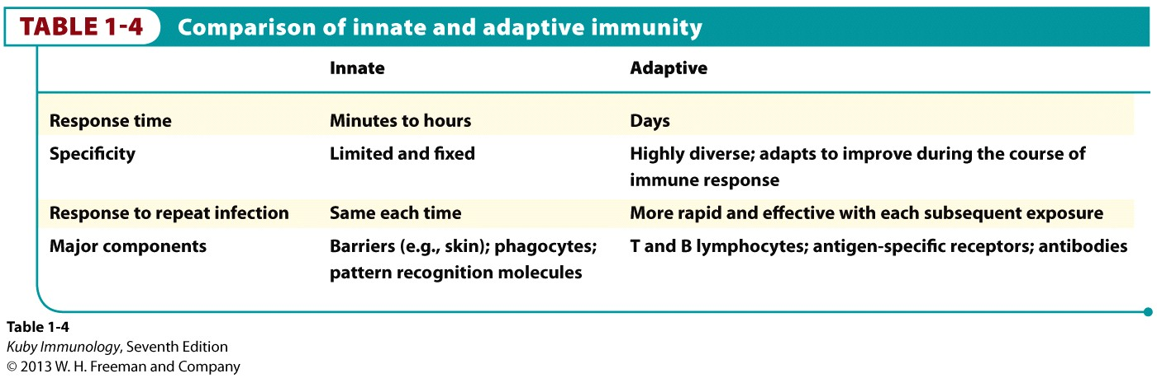
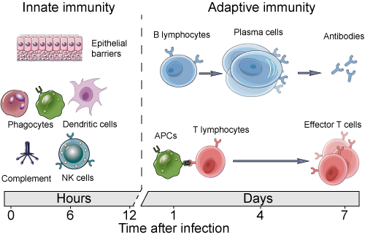
Innate vs Adaptive Differences at a glance

Slide 38
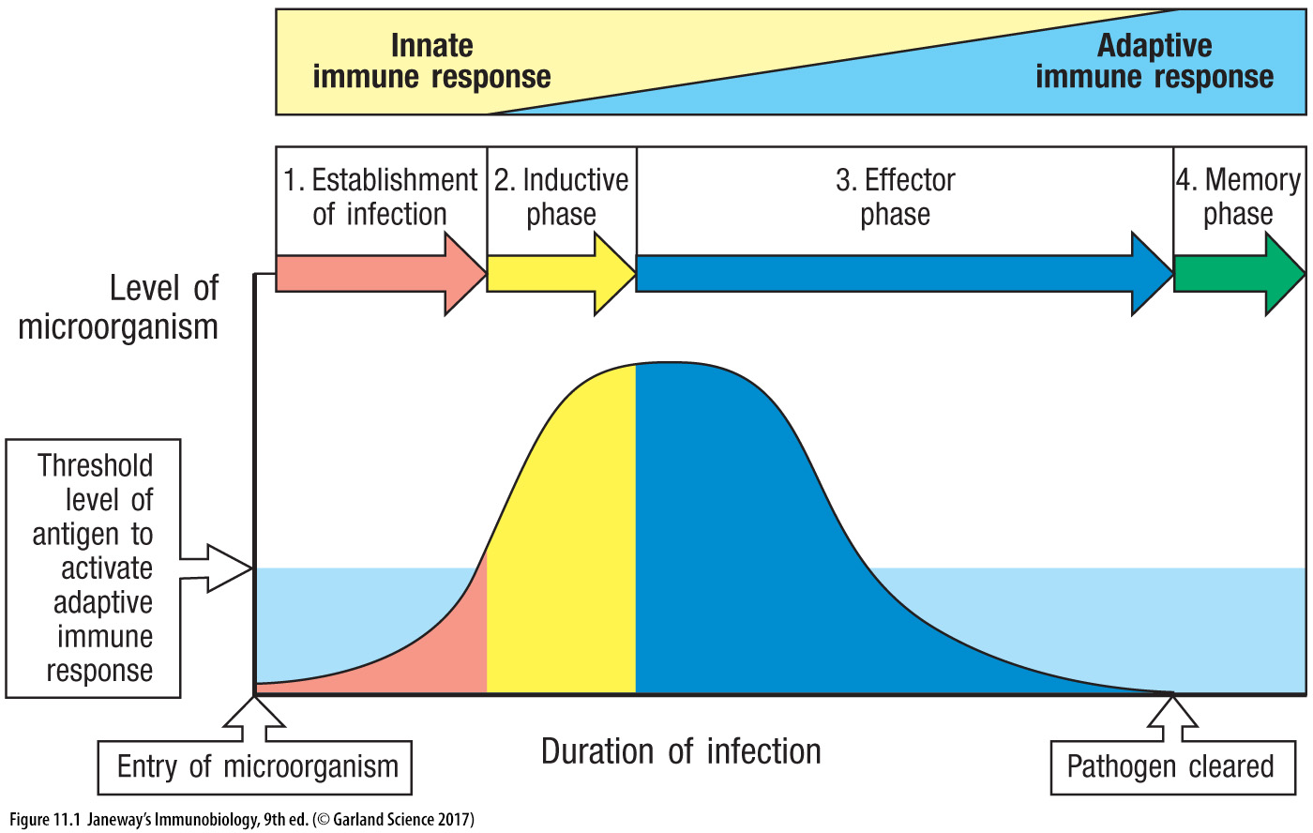
Innate vs Adaptive Timeline after infection

Slide 39
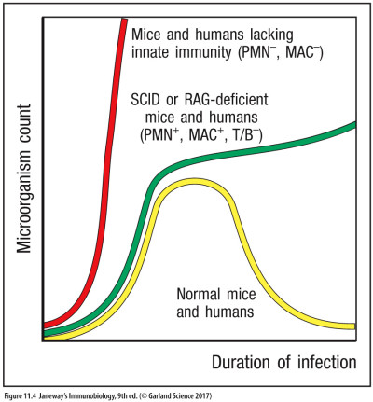
Innate vs Adaptive Which immunity confers more protection?
Losing the Innate arm of the immune system results in more disastrous outcome than losing the acquired arm

Slide 40
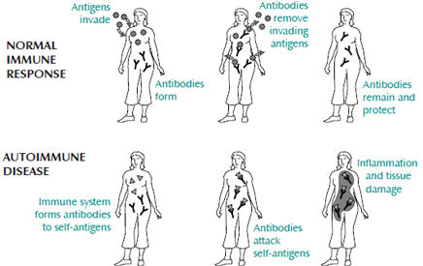
Autoimmune Diseases
Rheumatoid arthritis: A chronic inflammatory disorder affecting joints, mostly in the hands and feet.
Type 1 diabetes: A chronic condition in which the pancreas produces little or no insulin.
Notes:
Rheumatoid arthritis: A chronic inflammatory disorder affecting many joints, including those in the hands and feet.
Type 1 diabetes: A chronic condition in which the pancreas produces little or no insulin.

Slide 41
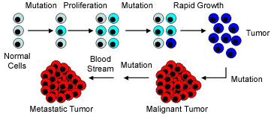
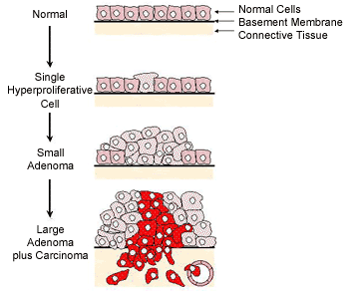
Cancer
Notes:
Several mutations must occur in the DNA of an individual cell for cancer to develop. Normal cells (light gray) from one of the body's organs may develop mutations that allow them to grow slightly faster than the cells around them. These mutated cells (light blue) are not tumor cells yet, because they must undergo further mutations before cancer can form. Cells developed from these light blue mutated cells form a "larger" target for future mutations because they grow slightly faster than the cells around them and because they already have at least one mutation on the way to forming cancer. Finally, when enough mutations are accumulated, cells (dark blue) form a tumor. The tumor cells are not yet malignant but will soon be if left untreated. Tumor cells develop further mutations and then change into malignant cancer cells (red). Malignant cells form a cancer at the original organ. These malignant cancer cells will develop still more mutations and then will spread (metastasize) to other organs through the bloodstream.
The steps involved in the formation of colon cancer or rectal cancer are shown. Cancer is a disease of cells. In the first drawing (labeled "normal"), note that each of the normal cells are about the same size, are organized in a orderly fashion, and are all on top of a basement membrane.A basement membrane separates these cells from other types of cells and from cells of different organs of the body. At some time, a normal cell develops enough mutations that it begins to grow slightly faster than the cells around it (the reddish cell in the center of the second drawing, labeled "single hyperproliferative cell"). Hyperproliferative means the cell grows faster than normal cells. When enough hyperproliferative cells accumulate, a small benign tumor called an adenoma develops (third drawing). During a colonoscopy, the doctor is looking for such adenomas. If an adenoma is removed at this stage, the patient will be fine and a cancer will not develop from this particular group of cells. Note two things about the adenoma in the third drawing: (1) the cells are starting to pile up on one another and they are not organized like normal cells, and (2) the cells are still on one side the basement membrane. If the adenoma is allowed to remain in the patient for many years, a cancerous tumor (called a carcinoma) will form inside of the adenoma. The cells in this carcinoma break through the basement membrane and will spread inside the colon, eventually leaving the colon to spread to other organs like the liver. In the fourth drawing, a tumor cell can be seen in the lower right hand corner breaking into a small blood vessel (pink segmented circle). Cancer cells often use body fluids like the bloodstream to spread or metastasize.

Slide 42
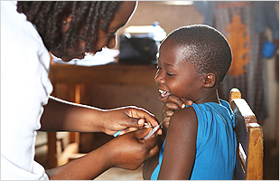
Vaccination (Immunization)
http://www.who.int/campaigns/

Slide 43
Drug vs Vaccine
Concept of Drug
Kill invaders OR foreign pathogens
Inhibit the growth of pathogens
Concept of Vaccine
Generate memory against specific pathogens
Trained immune system to face various existing disease causing agents

Slide 44
Vaccination: an ongoing global effort
Vaccination has yielded some of the most successful stories in alleviating worldwide mortality rates
The last case of naturally acquired case of small pox was reported in 1977
Consequence of eradication: universal vaccination not required
Most vaccine carry slight risk to the person vaccinated
In many cases every person do not need to be immune to protect most of the population
Herd immunity: if a critical mass of people acquire protective immunity they can serve buffer for the rest

Slide 45
Immunological Memory & Vaccination
Natural infections:
1st infection → memory → 2nd infection
slow response fast response
pathogens multiply pathogens disposed
Symptoms/disease no disease
Vaccination → memory → natural infections
no disease fast response
pathogens disposed
no disease
Vaccination protects us from infection by inducing the adaptive immune response, but bypassing the need for a natural infection

Slide 46
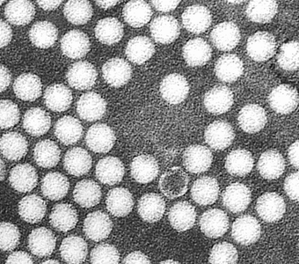
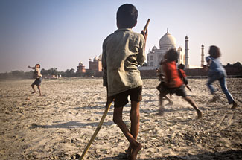
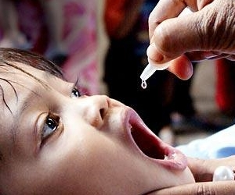
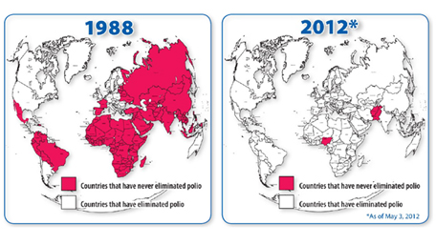
Vaccination Against Polio: A Great Success
Polio viruses
A boy with severe poliomyelitis
Administration of polio vaccine
World Status of Polio
Notes:
An updated figure may be?

Slide 47
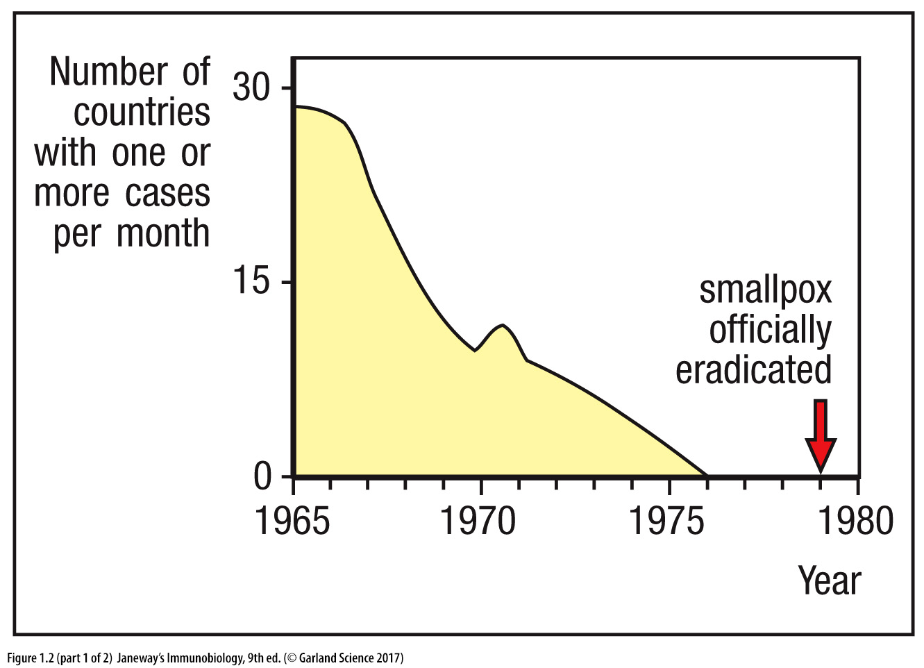
Small Pox officially eradicated in 1980 (WHO)
Notes:
All known stocks of smallpox were subsequently destroyed or transferred to two WHO-designated reference laboratories with BSL-4 facilities—the United States' Centers for Disease Control and Prevention and Russia's State Research Center of Virology and Biotechnology VECTOR.^{[80]}
Do we need this slide?

Slide 48
Types of vaccines
Live vaccines | Live Attenuated vaccines | Killed Inactivated vaccines | Toxoids | Cellular fraction vaccines | Recombinant vaccines
Small pox variola vaccine | BCG Typhoid oral Plague Oral polio Yellow fever Measles Mumps Rubella Intranasal Influenza Typhus | Typhoid Cholera Pertussis Plague Rabies Salk polio Intra-muscular influenza Japanise encephalitis | Diphtheria Tetanus | Meningococcal polysaccharide vaccine Pneumococcal polysaccharide vaccine Hepatitis B polypeptide vaccine | Hepatitis B vaccine

Slide 49
Live attenuated vaccine
Microorganisms lose their ability to cause pathogenicity
Retain capacity for transient growth
Killed Inactivated vaccine
Pathogens are killed by heat/chemicals
Still can induce an immune response
Killed vaccines often require repeated boosters
Subunit vaccine
Purified macromolecules derived from pathogens are used
Inactivated endotoxins/toxoids, capsular polysaccharides, surface glycoproteins
Recombinant vector vaccine
Attenuated organism serves as vectors
Individual genes that encode main antigens are introduced to attenuated pathogens

Slide 50
Routes of administration
Deep subcutaneous or intramuscular route (most vaccines)
Oral route (polio, BCG vaccine)
Intra-dermal route (BCG vaccine)
Scarification (small pox vaccine)
Intranasal route (live attenuated influenza vaccine)

Slide 51
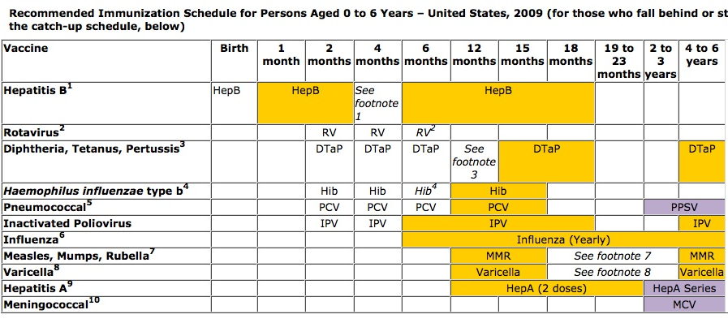
CDC Recommendation in the United States
Notes:
Can be skipped?

Slide 52
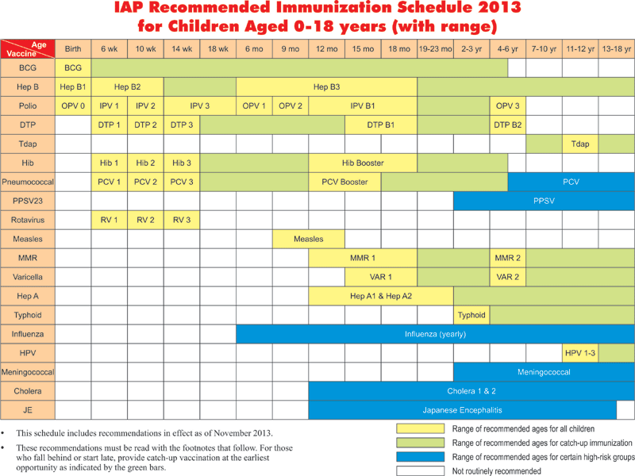
Indian Academy of Pediatrics

Slide 53
References
Janeway’s Immunobiology
https://www.youtube.com/watch?v=zQGOcOUBi6s

